Slide 1
Academic Performance in College Athletes
Claudia Geer & Sarah Marvin

Slide 2

Goal
Create a data-driven visualization tool to provide insights into the academic performance of NCAA student-athletes
Empower students to make informed decisions about potential universities based on academic performance
Assist NCAA and Athletic Departments in identifying trends and areas for improvement

Slide 3
Questions
01
How do academic scores and eligibility rates vary across NCAA divisions, conferences, schools, sport and gender?
02
What is the proportion of four-year athletes compared to single-year athletes across different NCAA divisions, sports, and conferences?
03
How do the historical retention rates of each college influence the current retention rates of four-year students at NCAA schools?

Slide 4
01 Question
How do academic scores and eligibility rates vary across NCAA divisions, conferences, schools, sport and gender?

Slide 5
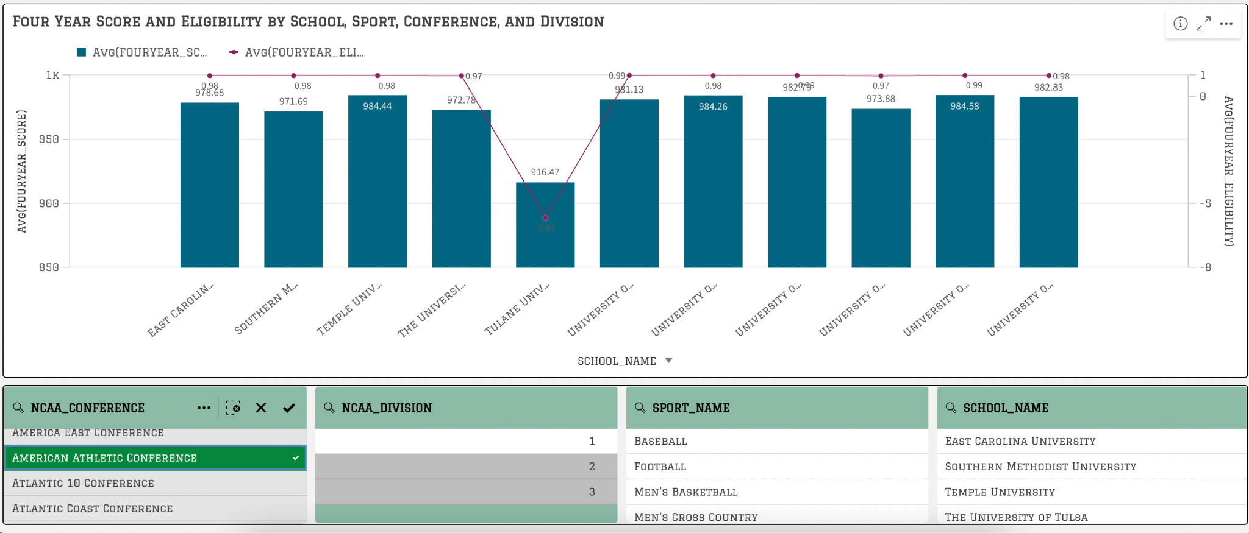

Slide 6
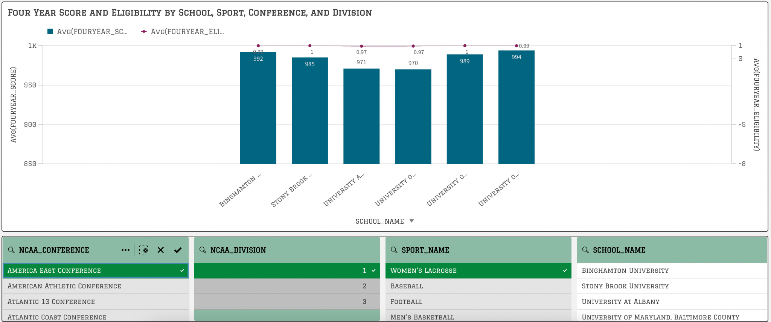

Slide 7
02 Question
What is the proportion of four-year athletes compared to single-year athletes across different NCAA divisions, sports, and conferences?

Slide 8
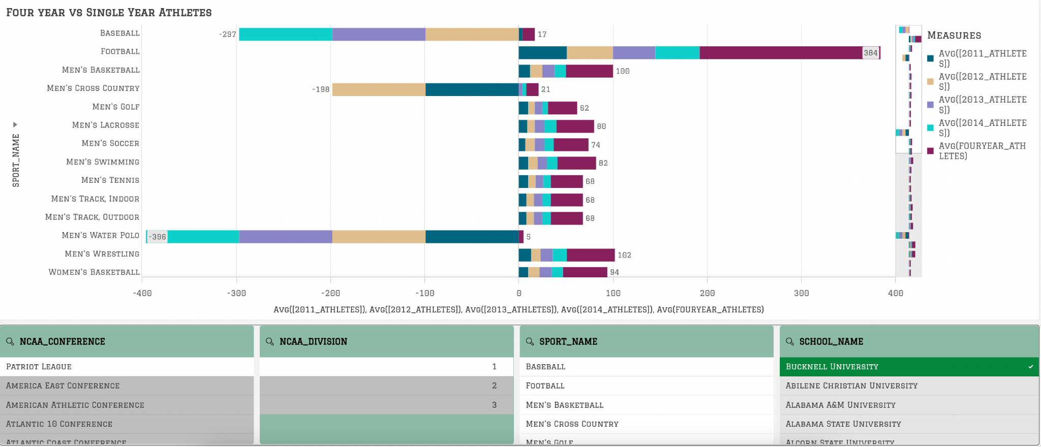

Slide 9
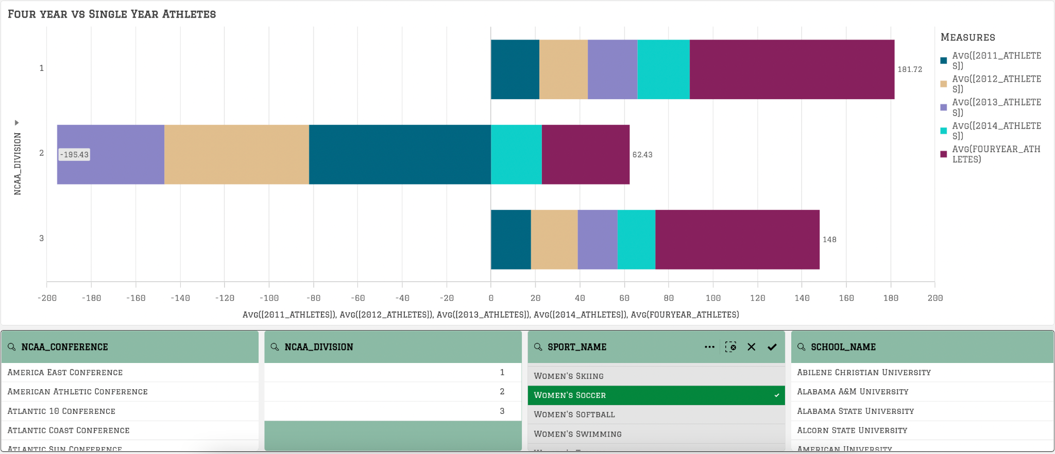
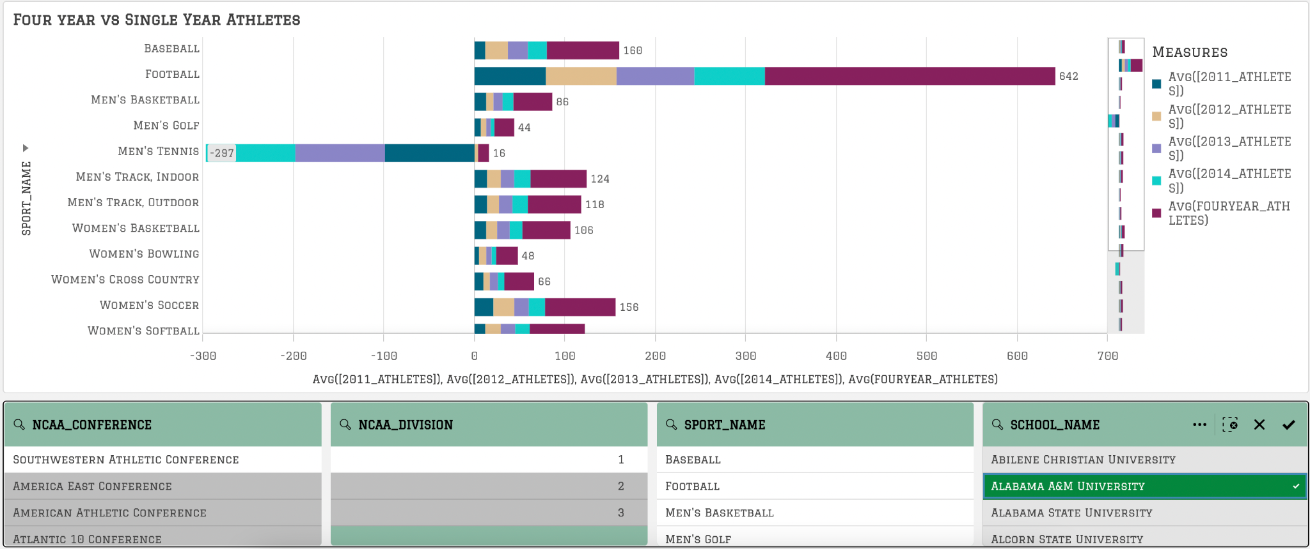

Slide 10
03 Question
How do the historical retention rates of each college influence the current retention rates of four-year students at NCAA schools?

Slide 11
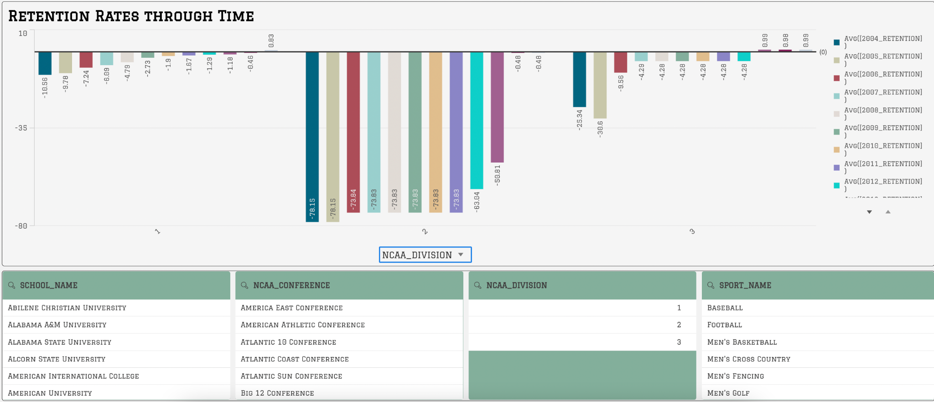

Slide 12
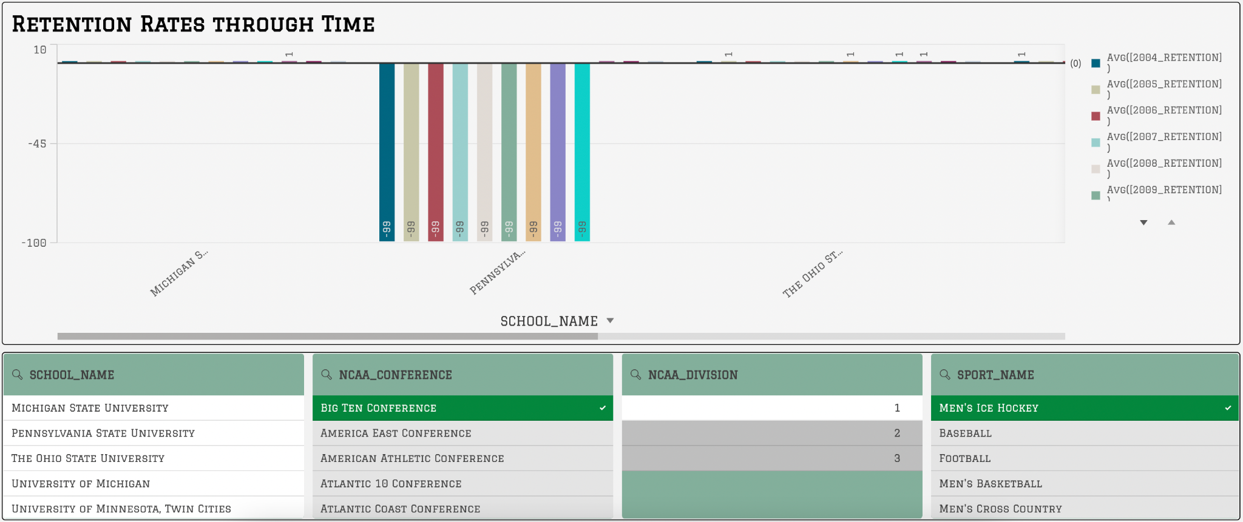
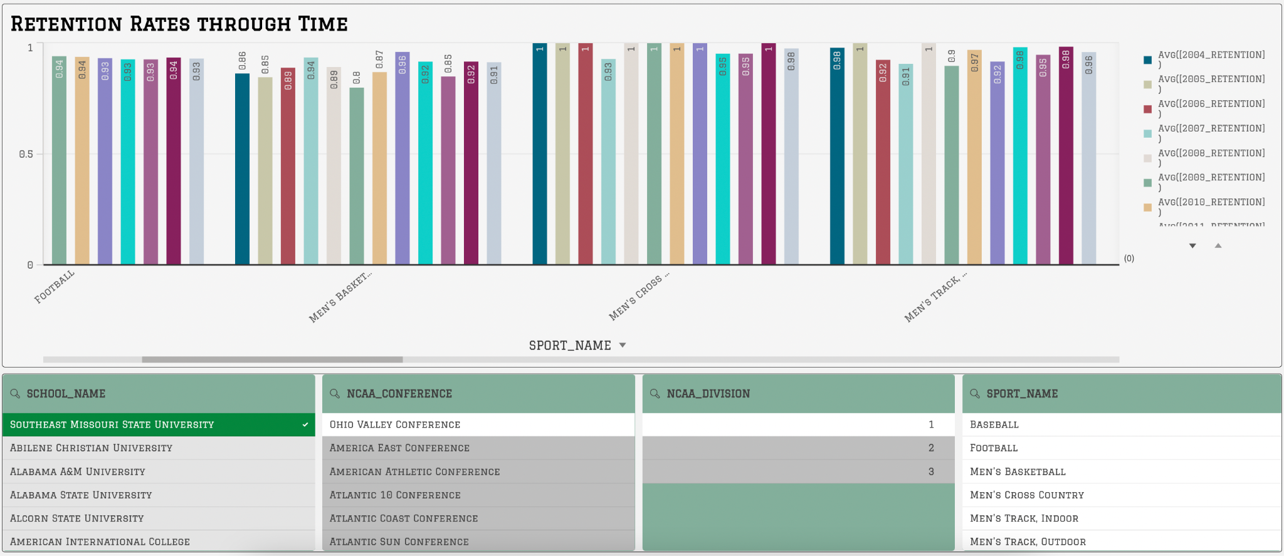

Slide 13
Thank You!

